Slide 1
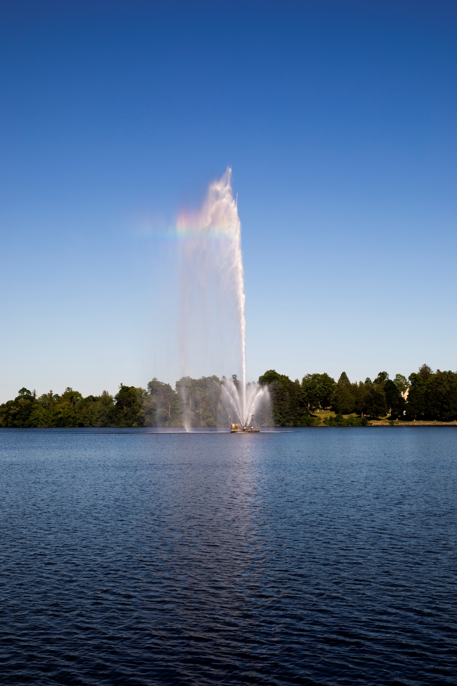

Slide 2
Secondary Suites in the City of Peterborough
September 19, 2018

Slide 3
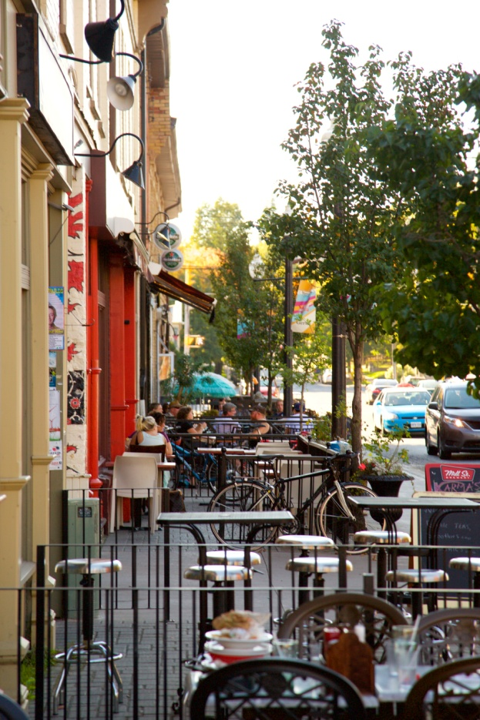
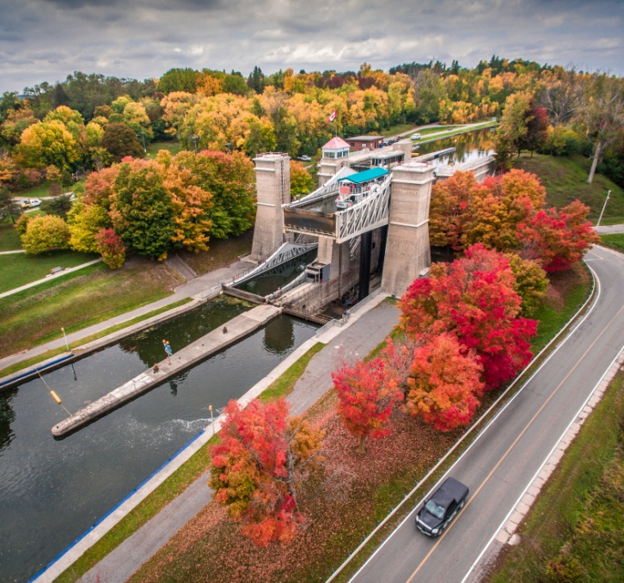
Welcome to Peterborough!

Slide 4
Welcome to Peterborough!

Slide 5
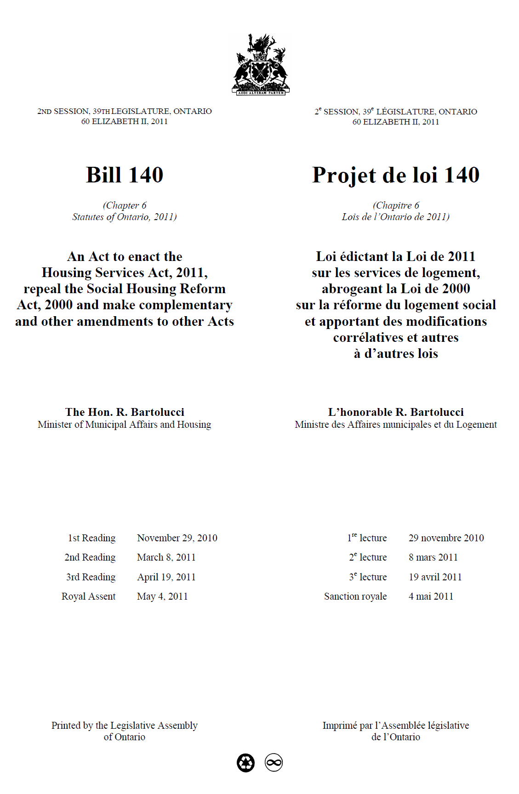
Secondary Suites Background
Planning Act amended in 2011(Bill 140)
Promote housing affordability
Municipalities are required to establish official plan policies and zoning by-law regulations to allow second units in…

Slide 6
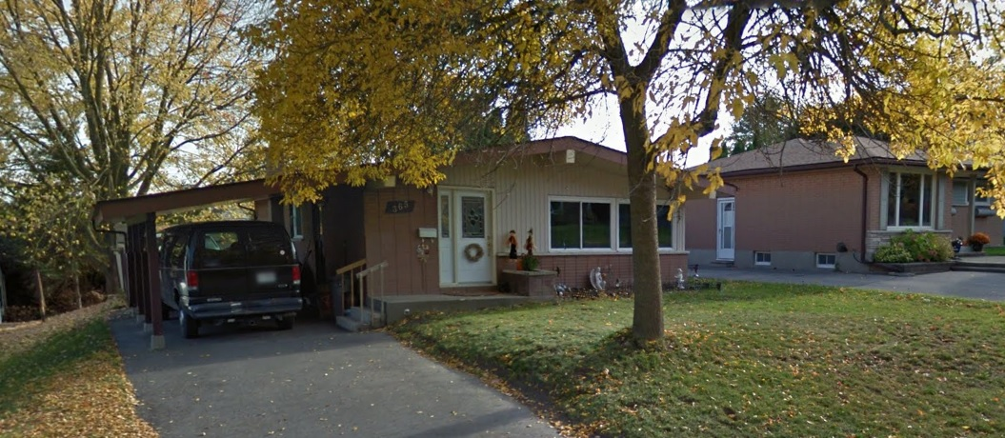
Background
Single Detached Houses

Slide 7
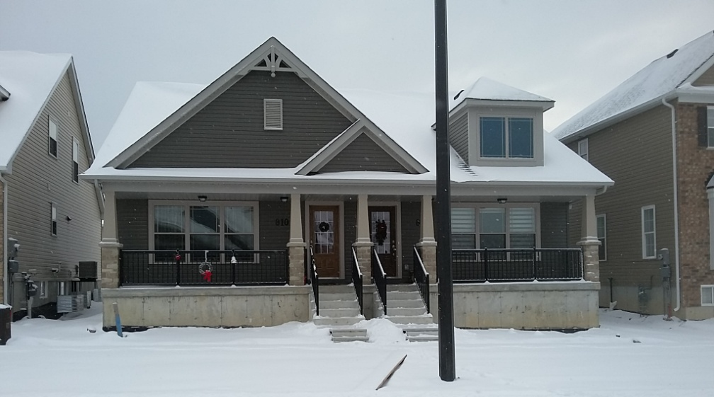
Background
Semi-detached Houses

Slide 8
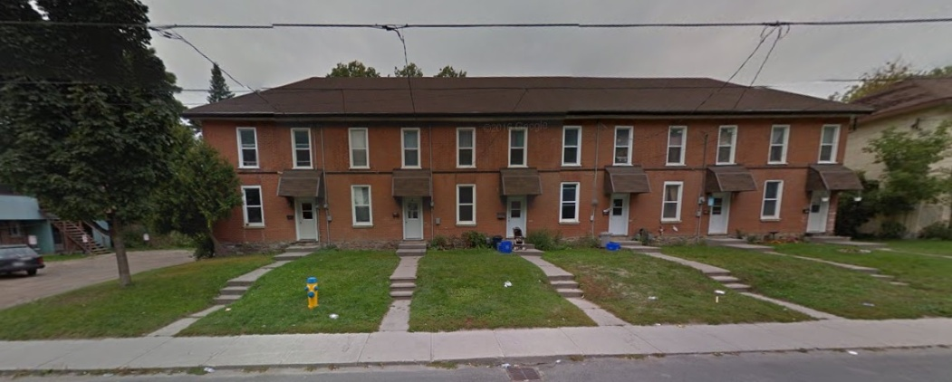
Background
Row or Town Houses

Slide 9
Background
Accessory Buildings

Slide 10
Background
What is a Secondary Suite?
Self contained residential units with a private kitchen, bathroom facilities and sleeping areas within dwellings or within structures ancillary to dwellings
Entrance is gained either through a separate entrance or through a common area

Slide 11
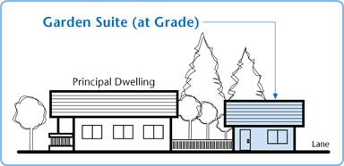
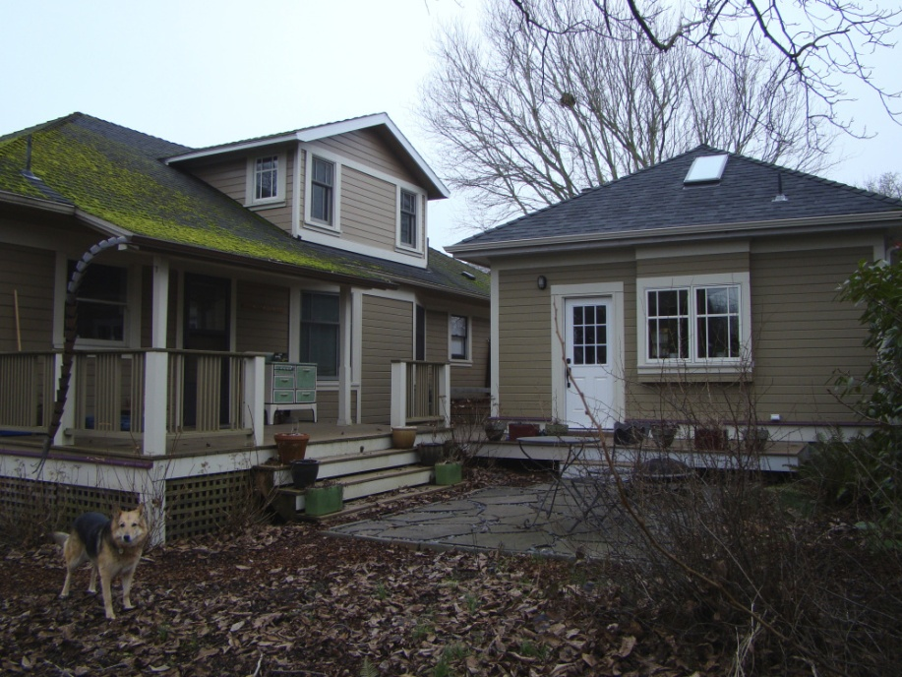
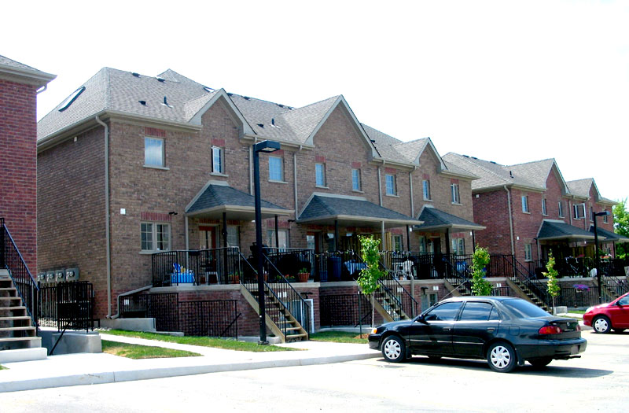
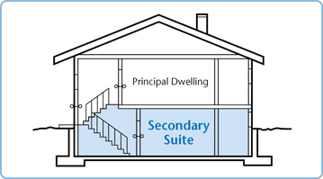
Background

Slide 12
Background: How Are Secondary Suites Currently Regulated?
Planning Approvals
Planning Act, Official Plan, Zoning By-law
Building Approvals
Ontario Building Code, Fire Code, Electrical Safety Code, Municipal By-laws
All Secondary Suites built after November 16, 1995 require a Building Permit

Slide 13
Provincial Considerations
Permit in both existing neighbourhoods and in newly developing areas
Consider constraints (e.g. flood plain, servicing availability)
Allow provincial statutes (e.g. Building Code, Fire Code) to take precedent
Ensure suites meet applicable law

Slide 14
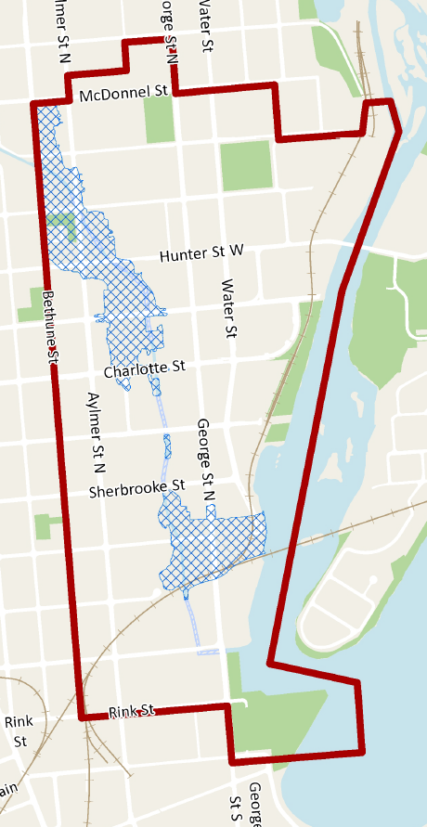
Current Situation – Peterborough Policy
McDonnel Street
“Additional Dwelling Units” permitted as of right in the Central Business District subject to regulations in the Zoning By-law
Bethune Street
Rink Street

Slide 15
Current Situation – 1994 Residents Rights Act (Bill 120)
Houses with 2 units used or occupied on November 16, 1995 may be grandfathered from zoning pursuant to the Apartments in Houses legislation from the mid-1990s

Slide 16
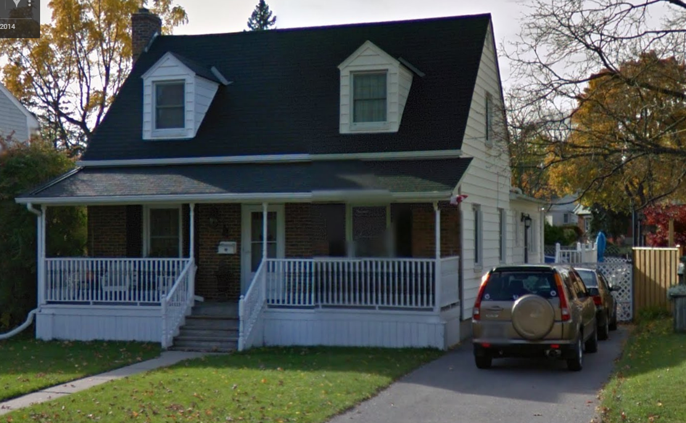
Current Situation – 1994 Residents Rights Act (Bill 120)
Secondary suites that created with a building permit between November 16, 1995 and May 22, 1996 are grandfathered from zoning as a permitted land use

Slide 17
Peterborough’s Solution

Slide 18
Peterborough’s Solution
May 22, 2018
Council Approval of Official Plan Amendment No. 177 and Zoning By-law 18-048
No appeals received; By-laws now in effect

Slide 19
Official Plan Amendment
Deleted obsolete policies and created a new policy to permit secondary suites in singles, semis, and row/towns
1 suite per principal dwelling
Allows detached suites
Prohibits severances
Prohibits suites in floodplain; discourages suites in proximity to erosion hazards
Requires municipal services unless zoning permits otherwise

Slide 20
Zoning By-law Amendment
Amended existing downtown zoning regulation to include new city-wide regulations
Downtown regulations remain but do not apply secondary suites in certain singles, semis or row/townhouses

Slide 21
Zoning By-law Amendment
Secondary Suites allowed throughout the City in single-detached, semi-detached and townhouse dwellings and in accessory buildings
Principal dwelling must be a permitted use in a residential zoning district
Limit 1 suite per principal dwelling
Does not apply to annexed areas under Township Zoning By-laws

Slide 22
Zoning By-law Amendment
Applicable Areas
Residential – Pink
Former Township Zoning – Dark Grey
Other Zones – Light Grey

Slide 23
Zoning By-law Amendment
Unit size:
Minimum: 28m² (300 sf)
Maximum: less than the floor area of the principal dwelling
Maximum Number of Bedrooms: 2

Slide 24
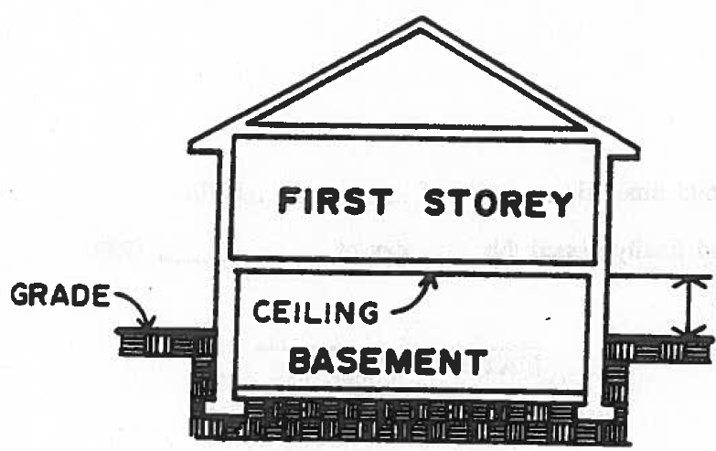
Zoning By-law Amendment
Removed basement ceiling height restrictions from Zoning By-law

Slide 25
Zoning By-law Amendment
Secondary Suites permitted in an accessory building:
Subject to the same regulations as all other accessory buildings (Section 6.18 of the Zoning By-law)

Slide 26
Detached Suites
Accessory buildings

Slide 27
Fire Access
Fire Department Access from street:
90 metre distance between fire hydrant and main entrance to suite; or,
Alternative fire access/suppression system approved by Fire Dept. and Building Division

Slide 28
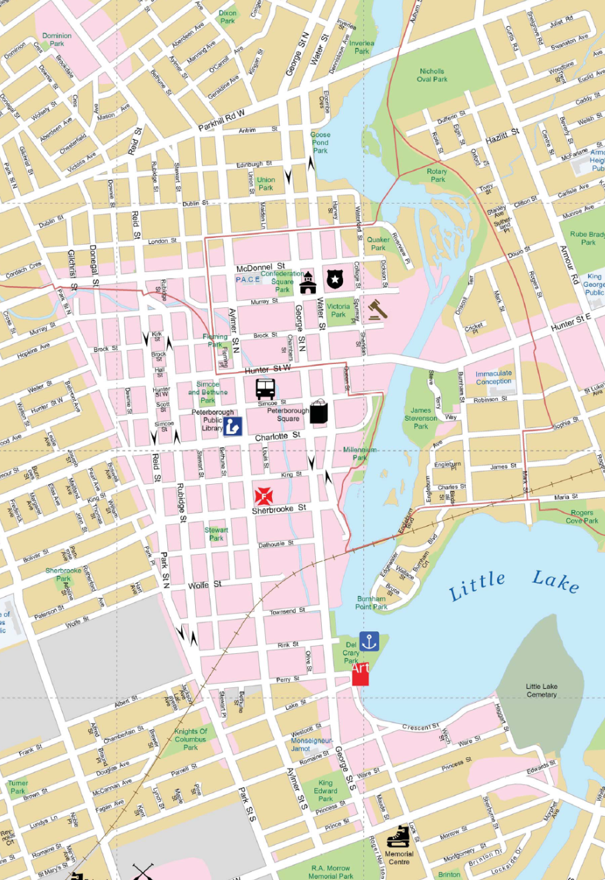
Parking
Area 3 (all other areas)
Parkhill Road
Area 2
Area 1: No additional parking required
Areas 2 and 3: 1 additional off-street space
Tandem Parking permitted
Area 2
Park Street
Area 1
Area 3
(all other
areas)
Lansdowne Street

Slide 29
Zoning By-law
Municipal servicing required
Private servicing permitted where allowed by zoning and approved by Health Unit (Ontario Building Code compliance)
Secondary Suites prohibited in flood plain areas

Slide 30
What does it all mean?
It is now possible to obtain a building permit to:
Install a new secondary suite
Legalize an existing secondary suite

Slide 31
A word of caution…
Development Charges could apply to a secondary suite
DCs currently apply to:
Secondary suites in new-build homes
Secondary suites in detached accessory buildings

Slide 32
A word of caution…
Development Charges could apply to a secondary suite
DCs may also apply to Secondary Suites created by way of an addition to an existing building (interpretation under review)
2018 City-wide DC: $22,183.00 plus Area Specific Charge ($3,000.00 to $10,000.00)

Slide 33
Next Steps: Proposed Registry
Registry (2019)
All secondary suites to be considered illegal unless registered
Power to inspect properties, prosecute violations, and impose fines
To be brought forward in the coming months
Outreach and Education
Online guidelines to come

Slide 34
Resources
E-Maps Peterborough Interactive Mapping
http://www.peterborough.ca/Living/City_Services/Geomatics_Mapping/Interactive_Map.htm
Airphotos
Parcel fabric and approximate dimensions
Zoning

Slide 35
Resources
Zoning By-law Text
http://www.peterborough.ca/Assets/City+Assets/Planning/Documents/Zoning+By-Law/Zoning+By-Law+Index.pdf?method=1

Slide 36
Resources
Otonabee Region Conservation Authority
http://www.otonabeeconservation.com/
Flood plain questions

Slide 37
Resources
County of Peterborough Interactive Mapping
https://www.ptbocounty.ca/en/living/maps.aspx
Flood plain

Slide 38
Resources
Planning Questions:
Brad Appleby, Planner, Subdivision Control & Special Projects
705-742-7777 ext. 1886
bappleby@peterborough.ca
Building Permit/Code Questions
Andrea Stillman, Permit Technician
705-742-7777 ext. 1795
astillman@peterborough.ca

