Slide 1
Two-Unit House Registration Process

Slide 2
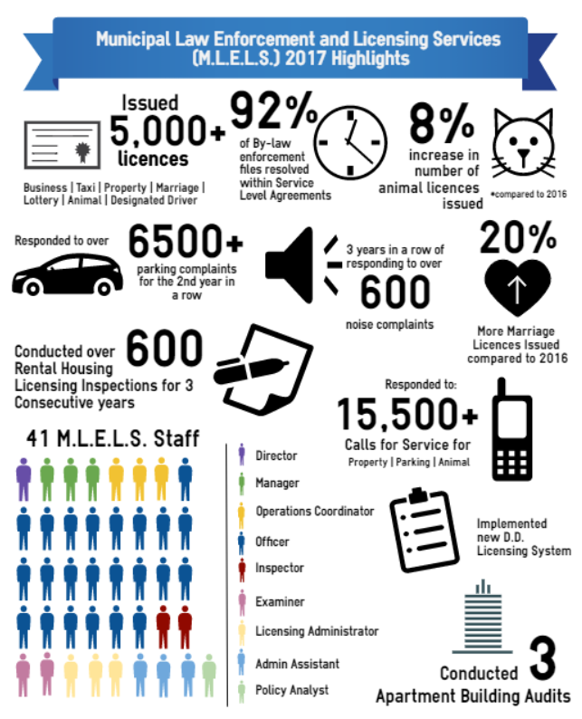
Introduction
Ken Man, M.P.A.
Manager, Policy and Research
Notes:
INTRODUCTION: Ken Man | Manager, Policy and Research
POLICY UNIT ➔ focus on municipal regulatory issues that spans from:
+animal control,
+to licensing taxis,
+to regulating housing standards
Our BRANCH, Municipal Law Enforcement and Licensing Standards, is the REGISTRAR for the two Unit Registration Process.
I do have to QUALIFY that I’m not a Building Code or Fire Code Specialist; I WON’T be able to speak to technical standards
Some of you might be upset about that, but that’s ok I know you guys all came out to see Mathew’s Presentation!

Slide 3
Information Session Overview
Purpose: Overview Oshawa’s Two-Unit Registration By-law
Two-Unit Registration
Background
Registration
Applicable Standards and Processes
Residential Rental Housing Licensing (R.R.H.L.)

Slide 4
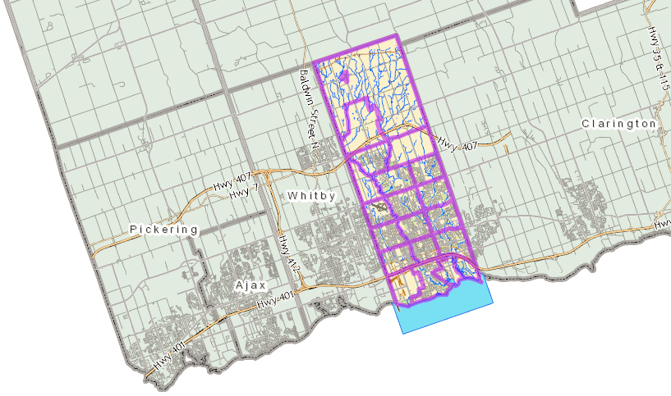
Information Session Overview
Information applies only to the City of Oshawa
Notes:
-This information applies only to the City of Oshawa.
-Other municipalities may have similar registration process; I can’t speak to that
-Best way to find out – contact:
- Fire Prevention
- Buildings Department

Slide 5
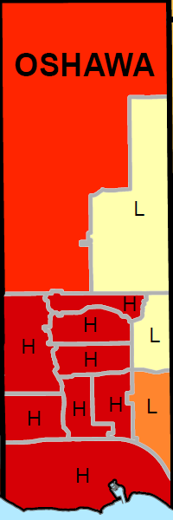
Local Context: City of Oshawa
32% of all units are Rentals (2016)
~21,000 rental dwelling units
2.5% vacancy rate (2017)
1200+ Registered Two-Unit
Renters
Notes:
You’re PROBABLY AWARE that there’s a strong demand for rental housing in Oshawa and here are some of the Numbers
-According to STATS CAN, 32% of all units are rentals (StatsCan 2016) ➔ HIGHEST % of rental units in Durham Region
-That translates to roughly 21,000 rental dwelling units
-We have a relatively low vacancy rate at 2.5%
-To date, we have over 1,200 registered Two Unit Dwellings
I want to THANK YOU all for taking the time to learn about how to legalize a Two-Unit ➔ OFTEN, individuals will just put one in without learning about the requirements

Slide 6
Background
Two-Unit House? A detached house, a semi-detached house or a row house which contains two self contained Residential Units (also referred to/defined as an “Accessory Apartment”)
Commonly Used Terms:
Basement Apartment
Secondary Apartment
Secondary Suite
In-Law Suite
Apartments in Houses
Two-Unit House
Notes:
In our Two-Unit Registration By-law, we define them as:
“A detached house…”
I believe, EX:
Toronto – “Secondary Suites”
Whitby and Ajax – “Accessory Apartments”
Clarington – “In-House Apartment”

Slide 7
Duplex v. Two-Unit
Duplex Two-Unit
DUPLEX: building originally constructed with two separate dwellings
TWO-UNIT or ACCESSORY APARTMENT: buildings originally constructed with one dwelling and converted to create a second dwelling unit.
Notes:
In the context of OSHAWA, it’s REALLY IMPORTANT to differentiate between a DUPLEX v. TWO-UNIT
While they both are DEFINED TERMS, Generally speaking:
-DUPLEX = is purpose-built building with TWO SEPARATE dwelling Units/Originally Constructed with two separate dwelling units
-TWO UNIT/ACCESSORY APARTMENT – originally constructed with ONE Dwelling unit but has been CONVERTED to include a second unit
SO in OSHAWA, “Duplexes” are DIFFERENT than “Two-Units”

Slide 8
Accessory Apartment v. Two-Unit
Accessory Apartment
Two-Unit
Two-Unit House: A detached house, a semi-detached house or a row house which contains two self contained Residential Units (also referred to/defined as an “Accessory Apartment”)
Notes:
Again, Accessory Apartments and Two-Units are the same thing

Slide 9
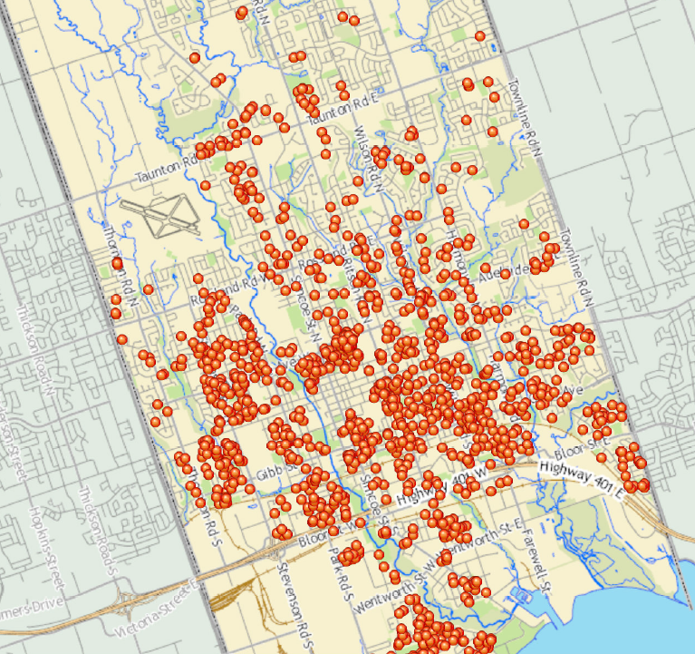
Background
Two-Unit House By-law 41-2001:
All two-unit houses must be registered
1200+ registered Two-Unit Houses
List of registered units online: www.oshawa.ca/twounit
All Registered Two-Unit Houses
(Sept 2017)
Notes:
-In Oshawa all Two Unit Houses must be registered with the City - it’s the law
-We have roughly 1,200 registered two-units ➔ depicted in the Map
-The list is regularly updated an maintained online at www.oshawa.ca/twounit

Slide 10
Timeline: Two-Unit House Standards
January 2012
Bill 140 passed; all municipalities required to permit Two Unit Houses
Pre 1994
Zoning By-law Regulates
Two Unit Houses
September 2001
Two Unit House Registration By-law
1994
To date
July 1994
Bill 120 Passed
June 2014
Oshawa Zoning By-law amended to permit Two Unit Houses in Singles and Semis subject to conditions
April 1996
Bill 20 passed
Legend:
Provincial Legislation
City of Oshawa Standard/Process
Notes:
WHEN IT COMES TO REGISTRATION SYSTEM, it’s important to understand the history ➔ this will explain why DEPENDING ON WHEN the Second Unit Was Constructed, different standards may apply.
Municipalities are what’s termed “CREATURES of the PROVINCE” – this means, we “take our marching orders” from the Province
Before 94, ZBL regulated where Two-Units were permitted
Bill 120: Resident’s Rights Act, 1994 = Zoning standards do not apply; just Fire and Property Standards
Bill 20 = Restored municipalities' ability to control where two-unit houses via ZONING By-law
Two-Unit House By-law 41-2001 Comes into effect in Sept 2001 – all two units must be registered
Bill 140: Strong Communities through Affordable Housing Act = Requires the establishment of Official Plan and Zoning criteria to provide for second units
In 2014, we amended out ZBL to comply

Slide 11
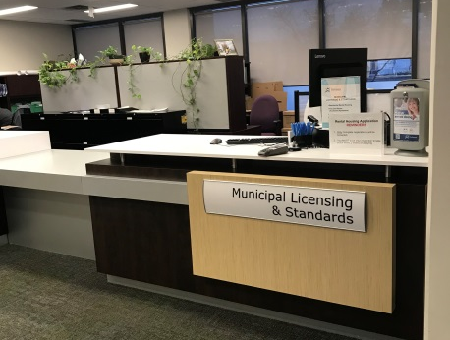
Why Registration?
Ensure converted dwellings meet minimum safety and design standards:
 | Building Code
 | Fire Code
 | Electrical Safety
 | Property Standards
 | Zoning
Notes:
Why do we have a registration system? Is it a CASH GRAB?
NO! – our inspectors have seen some pretty questionable conversions ex. closets turned into showers without ventilation
Registration ensures that the CONVERTED DWELLING meets MINIMUM safety and design standards ex.
PROVINCIAL STANDARDS:
+Building Code – minimum construction standards for new construction and renovations
+Fire Code – minimum standards for Fire Safety
+Electrical Safety Code – minimum standards for electrical safety
CITY STANDARDS:
+Property Standards – minimum standards for property maintenance and repair (applies – existing construction)
+ZBL – controls land use (ex. “what can be built where”)

Slide 12
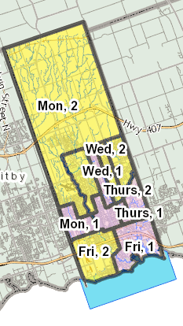
Why Registration?
Track City-approved Two-Units
Inform tenants that Two-Unit has been City-inspected
Assists with municipal planning and other services:
Waste collection
Emergency services planning
Notes:
In addition to maintaining minimum safety and design standards…
Registration system allows:
-City to track approved units
-inform tenants which units have been City-inspected/approved
More importantly,
-it assist with City planning when it comes to WASTE collection and EMERGENCY SERVICES planning

Slide 13
How to Register

Slide 14
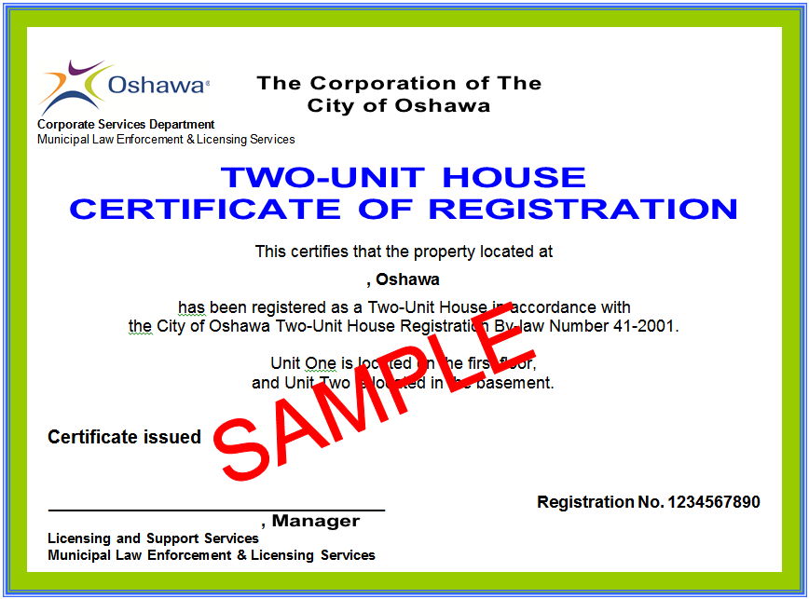
Zoning Requirements
Detached or Semi-Detached
Permitted use in the Zone: R1, R2, R5, OSR-A, ORM, AG-A, AG-B or AG-ORM
Only one (1) Two-Unit/Accessory Apartment per lot
Minimum lot frontage of eleven (11) metres
Minimum of three (3) parking spaces are required
Notes:
To Register, the Second Unit must comply with:
1)Zoning Standards
2)Construction Standards
ZBL:
-Detached or Semi-Detached
-Permitted in a Zone that permits Single and Semi-Detached: R1, R2…
-Only 1 Two-Unit is permitted per lot
-Have a minimum of 3 parking spaced
+Each must be 2.75 m x 5.75 m
+2 of the 3 spaces must have direct access to the street (only one space can be in tandem or in garage)

Slide 15
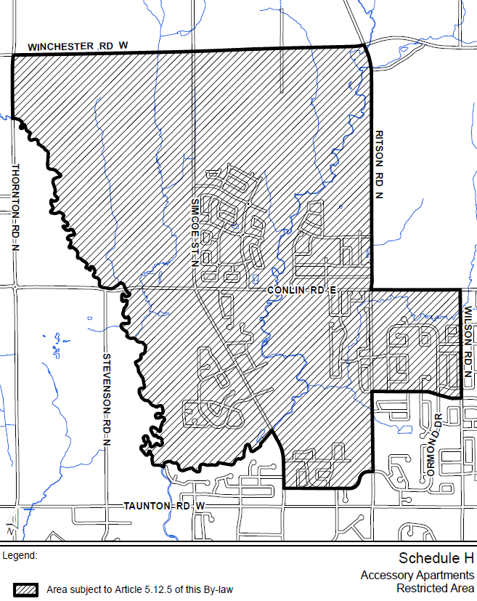
Zoning Requirements: Restricted Area
Two-Units Prohibited in Restricted Area (Schedule “H” of Zoning By-law)
Reason:
Sanitary Sewer Constraints
Encourage density along Simcoe St. North Corridor
Notes:
The ZBL also prohibits Two-Units in the area around the University of Ontario Institute of Technology/Durham College
Reason:
-Not enough capacity for Sanitary Sewers
-The City’s objective is to encourage higher density along the Simcoe St. N Corridor

Slide 16
Other Requirements
Legislation/By-law | Examples of Main Standards
Building Code | Smoke/CO alarms Exits Sound rating | Fire separations Window sizes HVAC | Ceiling height Room sizes Ventilation
Fire Code | Smoke alarms CO alarms | Fire separations Egress | Electrical Safety Authority Inspection
Property Standards By-law | Ceiling heights (6.5 ft.) Windows General safety and maintenance standards for existing and approved units
Notes:
In terms of Construction Standards – this really depends on when the Second Unit was constructed
GENERALLY SPEAKING:
Units Constructed BEFORE July 1994 ➔ Property Standards By-law + Fire Code
Units Constructed AFTER July 1994 ➔ Building Code + Fire Code

Slide 17
Old Process
 | Process | Where to go (Registrar) | Inspection
Existing Unit (Before March 2017) | Apply for Two-Unit Registration Initial Property Standards/Fire Inspection Re-inspection Register Two Unit | Licensing | Licensing & Fire
New Unit | Apply for Building Permit Building Permit Issued Inspection Register Two-Unit | Buildings | Buildings & Fire

Slide 18
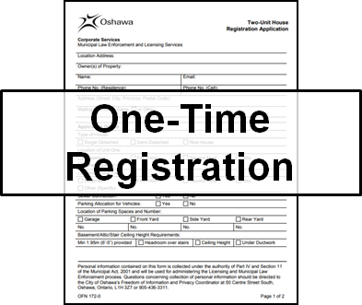
New Process
 | Process | Where to go (Registrar) | Inspection
Existing Unit (Pre-July 1994) | Apply for Two-Unit Registration Initial Property Standards/Fire Inspection Re-inspection Register Two Unit | Licensing | Licensing & Fire
Post-July 1994 & New Unit | Apply for Building Permit Building Permit Issued Inspection Register Two-Unit | Buildings | Buildings & Fire
Notes:
Based on a updated INTERPRETATION of Provincial Legislation, the City is implementing a new process:
There are two (2) processes:
If your UNIT:
Existed BEFORE 1994 –application to Licensing and Standards and the inspections will be undertaken by our Licensing + Fire Inspectors
Existed AFTER 1994 – application to Building Services and the inspections will be undertaken by Buildings and Fire Inspectors

Slide 19
What You Need For Registration: PRE-1994
Where to go: Licensing and Standards
Review List of Registered Two-Units
Contact Licensing and Standards: Duplex v. Two-Unit
Documentation of year of Two-Unit
Fill out application + pay fee
Provide supporting documents (if applicable)
Notes:
Again, if you’re coming to Licensing and Standards
You’ll want to:
1)Check that the second unit is not already registered
2)Contact Licensing and Standards to confirm that the unit is NOT a DUPLEX
3)If you have documentation proving PRE-94
Examples of Documentation of YEAR:
-Lease agreements
-Invoices from contractors etc.
4) Fill out an application + pay a fee
5) Provide any necessary supporting documents the City requests

Slide 20
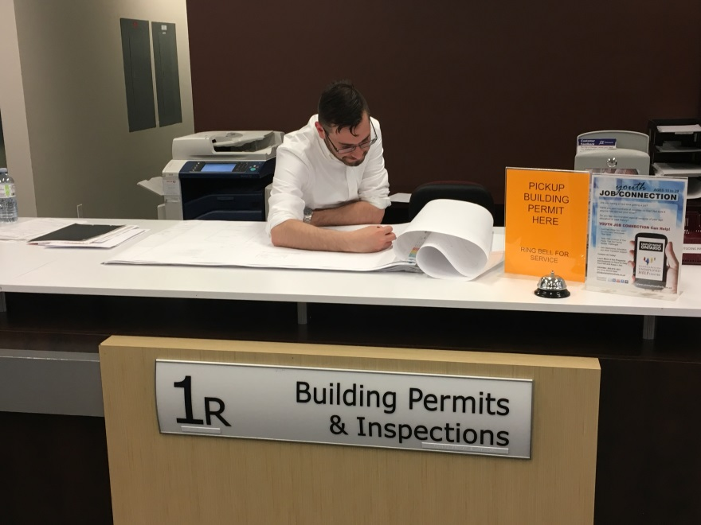
What You Need For Registration: POST 1994 + New Construction
Where to go: Building Services
Submit Building Permit Application + Fee
Plans and Drawings
Notes:
If you are registering a unit that’s existed AFTER 1994 or putting a new Unit ➔ Building Services
Buildings Fee: $6.52 sq/m
average fee: $500

Slide 21
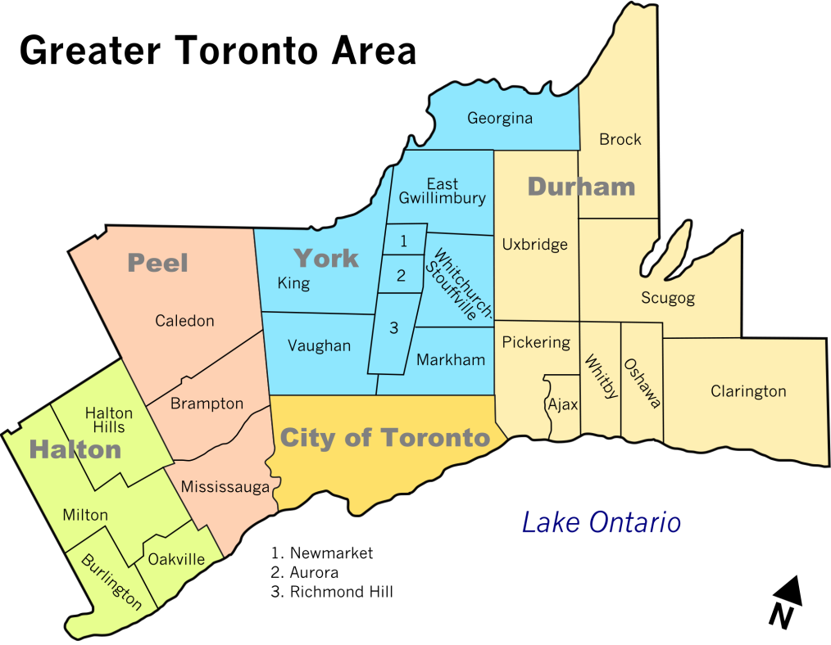
Other Municipalities: Two-Unit Registrations
Contact:
Fire Prevention
Building Services
Notes:
Again, this process is for the City of Oshawa ➔ other municipalities may have similar processes
Check with their Fire Prevention or Building Services departments

Slide 22
Residential Rental House Licensing (R.R.H.L.)
Notes:
That concludes my presentation on TWO UNITS – but I do want to quickly plug our other Rental Property Licensing System which I think is applicable.
The City has another licensing system called the R.R.H.L.

Slide 23
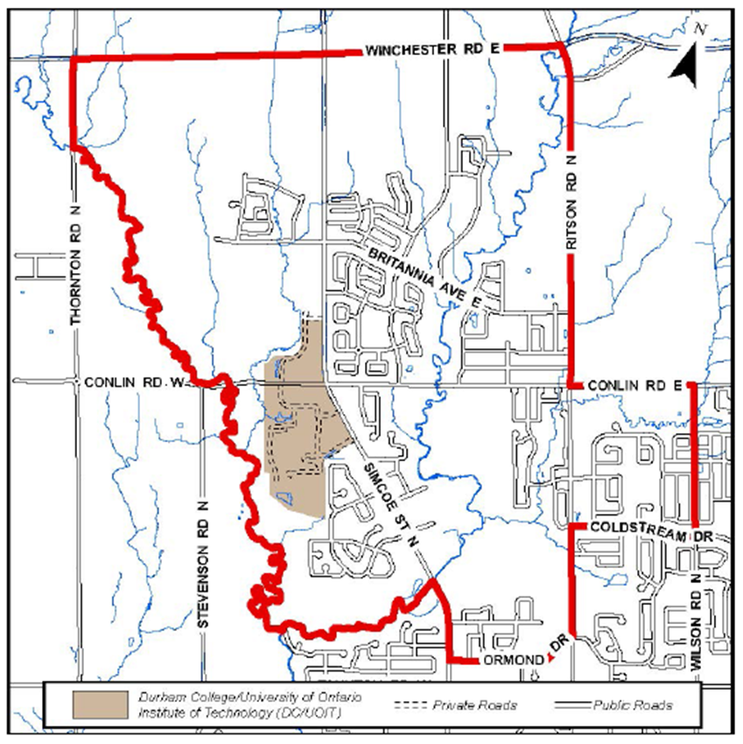
Residential Rental House Licensing System
All rental properties located within the “rental area” to be licensed
Notes:
The R.R.H.L. requires ALL RENTALS within the “Rental Area” to be licensed ANNUALLY with the City
The R.R.H.L. is similar to the Two Unit Registration in that the licensing system ensures that:
+minimum standards of health and safety are met; and
+land-use intensification is addressed.
You might notice that the TWO UNIT restricted area is exactly the same as the RENTAL AREA ➔ control intensification

Slide 24
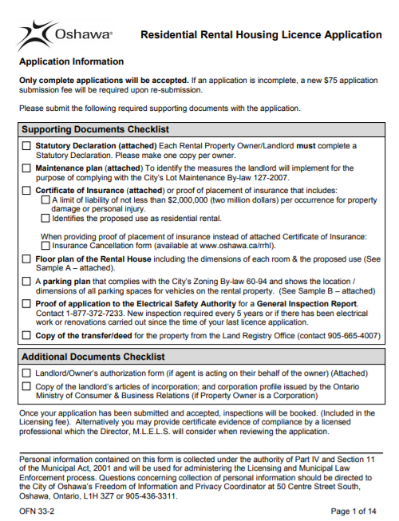
Residential Rental House Licensing System
Annual licence + Inspections
Properties must comply with various standards:
Fire Code
Building Code
Zoning By-law
Property Standards By-law
Lot Maintenance By-law
Waste Collection By-law
Etc.
Limit of Four (4) Bedrooms
Notes:
Fees - $500 first time
$360 on early renewal if submitted more than 60 days before expiry
$500 if otherwise

Slide 25
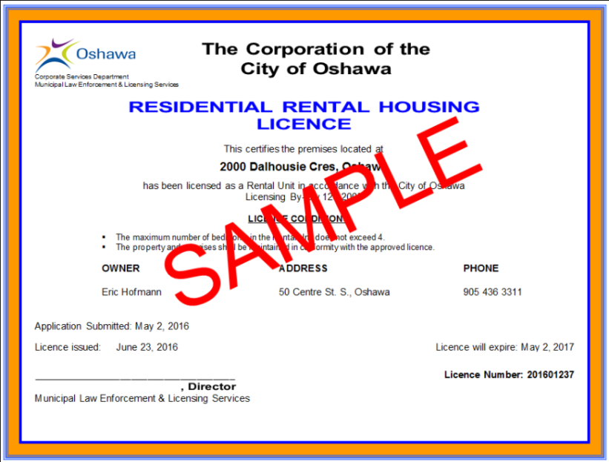
Residential Rental House Licensing Area
Submit application to Licensing and Standards with fee
Application Review
Annual licence fee
Inspections with Fire Services, Licensing and Standards
Requires E.S.A. certificate
Notes:
-A realtor can act as an Agent for the Home Owner in the application process, but needs written authorization from the Owner
-Fees - $500 first time, $360 on early renewal if submitted more than 60 days before expiry, $500 to renew if otherwise
-Application also requires documents such as a floor plan

Slide 26
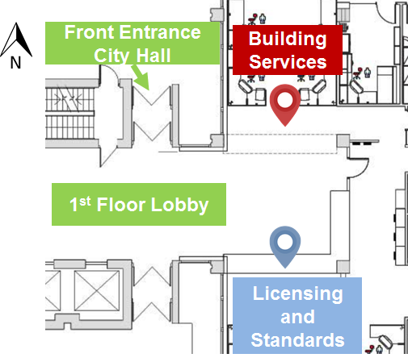
Technical Information
Building Services
905-436-5658
buildings@oshawa.ca
Licensing and Standards
905-436-3311 ext. 2299
lic_stand@oshawa.ca
www.oshawa.ca/twounit
www.oshawa.ca/residents/building-and-renovating.asp
www.oshawa.ca/rrhl

Slide 27
Q & A

